Slide 1
Research paper analysis and proposal
By Eric Lamphear, Ji li, and Bhavdeep Singh

Slide 2
overview
Review of Denial of Service via Algorithmic Complexity Attacks by Crosby and Wallach
Summary of the paper’s findings is that algorithms are often (though not always) implemented expecting the ‘average case’ amount of complexity in the incoming data to be processed and may not adequately prepare for the ‘worse case’ occurring.
This can open the software up to denial-of-service (DoS) attacks that will bring the software down due to a flood of data into the algorithm.
This may result in relatively minor outages in non-critical applications or websites, but if applied to network security or monitoring software (such as intrusion detection software (IDS)) could provide an opening for other attacks into a vulnerable system.

Slide 3
Example Algorithm – hash tables
Authors focused on hash-table algorithm implementations
A hash table is an array that uses a hashing function to associate “keys” to the buckets their corresponding data is stored in
Considered the case of attempting to force incoming data to all get sorted into the same ‘bucket’ in the hash table to force worse-case complexity and computation time
Compared attack methods of forcing collisions in the hash overall vs. attempting to target collisions to a particular bucket.
Authors felt that forcing collisions at the hash level will result in bucket collisions without needing to attempt to determine a particular bucket to use

Slide 4
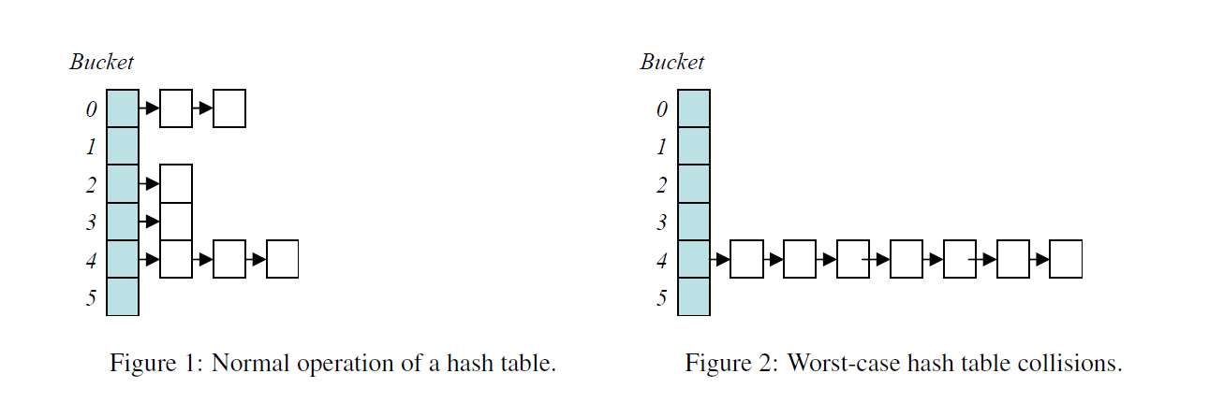
Example algorithm - Hash table Collisions

Slide 5
Paper’s example algorithm – Hash table attack results
The authors conducted a study of several applications to see if they could produce marked performance degradation across several programs.
Squid (web proxy cache) – Able to demonstrate an increase from 10 mins to 14 mins
DJBDNS (DNS service) – Determined to have built-in ‘hash flooding’ protection
PERL (programming language) – Able to apply an exponential increase in server-side computation time
Bro (IDS) – Able to produce significant lag, which could allow other attacks to bypass the IDS monitoring
Conclusion reached by the authors is to recommend implementing “universal hash functions” in hash tables to provide a layer of security against such attacks

Slide 6
Proposed attack – on a heap sort algorithm
Good data we feed the system
System process the data using HeapSort
System did NOT take long time for processing data and attack failure
Bad data we feed the system
System process the data using HeapSort
System took very very very long time for processing data and attack success

Slide 7
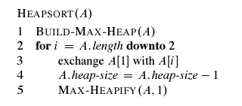
Considering heap sort at the first step
1
1
2
3
8
7
4
5
6
7
4
5
6
3
8
9
2
9
Before 1st step max-heapify all elements did not follow the rule of max heap.
After 1st step max-heapify ONLY ONE element was not max-heaped, and max-heapify this heap is much easier than the left figure.

Slide 8
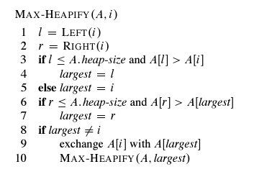
Increasing complexity of heap sort
1
2
3
4
5
6
7
8
9
In ascending order, all syntax in max – heapify process will go through, and it could take max time for MAX-HEAPFY(A,1)

Slide 9
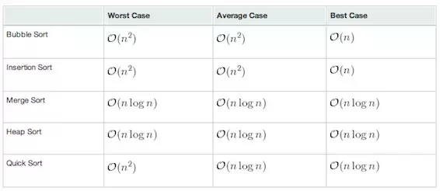
Time complexity comparison

